Slide 1
Editable Detail Views
November 28, 2014
Notes:
Guidewire training materials contain Guidewire proprietary information that is subject to confidentiality and non-disclosure agreements. You agree to use the information in this manual solely for the purpose of training to implement Guidewire software solutions. You also agree not to disclose the information in this manual to third parties or copy this manual without prior written consent from Guidewire. Guidewire training may be given only by Guidewire employees or certified Guidewire partners under the appropriate agreement with Guidewire.
1

Slide 2
Describe how to make a detail view panel editable
Create a toolbar with edit buttons
Notes:
1

Slide 3
Discover editability
Configure the editability of a detail view panel
Notes:
<number>

Slide 4
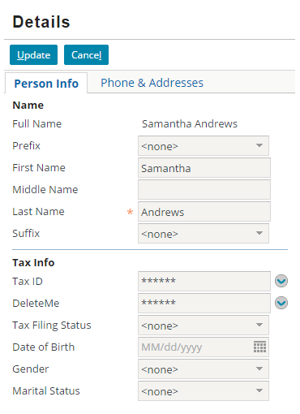
Screen
A Screen is the top-level user interface container for the visible content of a page
When in edit mode, users can edit all editable input widgets
Screen
Notes:
A Screen is the top-level container widget for the visible content of a page. When in edit mode, all the input widgets contained within a Screen become editable unless otherwise specified (in a parent container or widget itself) to not be editable.
<number>

Slide 5
Screen transaction
A screen transaction has a beginning and an end in which all the data on the screen either is committed to the Guidewire application database or rolled back and not committed
Screen
begin transaction insert… update…
delete… commit
Notes:
The term "screen transaction" is for educational and training purposes only. The terms describes the process of committing data on the screen to the Guidewire application database. If the data commit completely succeeds, all database changes happen in a single database transaction. If the commit attempt fails in any way, the entire update fails and Gosu throws an exception.
"Database transaction" is a similar term. Guidewire product database are not, by default, distributed transactions. A distributed transaction, sometimes referred to as a global transaction, is a set of two or more related transactions that must be managed in a coordinated way.
"Transaction" is a term that various Guidewire products define differently. Consider the following examples:
A "policy transaction" is job process that creates or modifies a policy such as a policy change, a cancellation, or a renewal.
In PolicyCenter, a "financial transaction" represents the change in costs for a given quotable aspect of a policy, e.g., the decrease of a deductible in collision coverage increases the cost from $10 to $17.
In BillingCenter, a "financial transaction" refers to the debit of money from one T-account to the credit of money to another T-account.
In ClaimCenter, a "financial transaction" describes the movement of money either set aside for a payment into a reserve line or out of a reserve line to make a payment.
<number>

Slide 6
Edit buttons on a screen
Edit buttons on a screen control the input widget modes and the screen transaction
Screen
begin transaction insert… update…
delete… commit
Edit Buttons
Notes:
A Screen is the top-level container widget for the visible content of a page. By placing a toolbar in a screen, you can add edit buttons. When in edit mode, all the input widgets contained within a Screen become editable unless otherwise specified (in a parent container or widget itself) to not be editable.
<number>

Slide 7
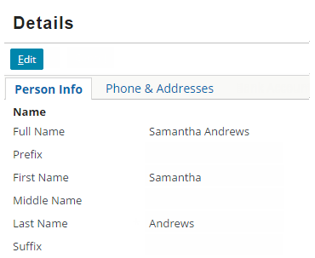
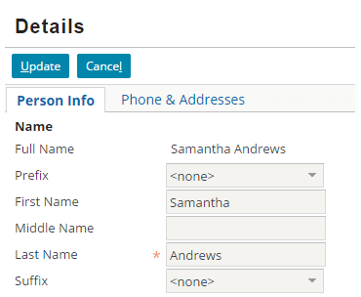
Edit Buttons control input widget modes
Read-only mode
Edit mode
Input widgets displays root object data and related data
Input widgets allow for editing of root object data and related data
Notes:
The Edit Buttons control the input widget modes. By clicking Edit, the input widgets become editable. By clicking Update or Cancel, the input widgets become read-only.
<number>

Slide 8
Edit Buttons control the screen transaction
Click Edit
Click Update
Click Cancel
Enter edit mode
Add entry to unsaved menu
Commit changes
Return to read-only with changed data
Remove entry from unsaved menu
Discard changes
Return to read-only with unchanged data
Remove entry from unsaved menu
Notes:
When a user clicks Edit, the input widgets switch from read-only to edit mode. In addition, an entry is made in the unsaved work menu for the data backed object (entity) on the screen.
When a user clicks Update, the Guidewire application commits the changes to the data backed object on the screen; the input widgets switch from edit mode to read-only mode; and the entry in the unsaved work menu for the data backed object (entity) on the screen is removed.
When a user clicks Cancel, the Guidewire application does not commit the changes to the data backed object on the screen; the input widgets switch from edit mode to read-only mode; and the entry in the unsaved work menu for the data backed object (entity) on the screen is removed.
<number>

Slide 9
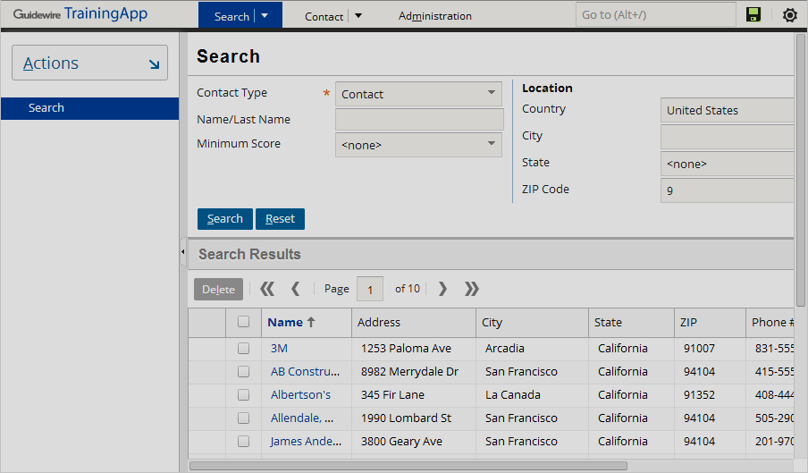
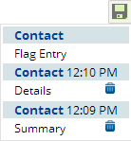
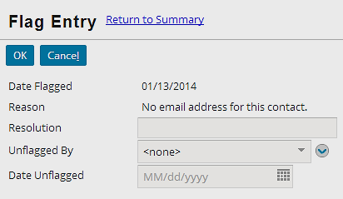
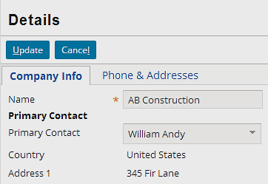
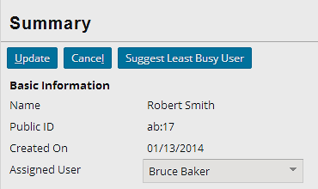
Edit buttons and the unsaved work menu
Click Edit to automatically add object to unsaved work menu
Update or Cancel removes entry
Notes:
Whenever you start editing a data backed object (entity), the Guidewire application automatically adds an entry to the Unsaved Work menu. The entry remains in the Unsaved Work menu until the data is committed (click update) or you log off.
Users can use the Unsaved Work menu to return to unsaved work, even after they navigate away from the current screen.
<number>

Slide 10
Editable hierarchy
By default, all containers are:
Editable and visible
For widgets to be editable, parent container must also be editable
Editable hierarchy starts with Location
Editable property is undefined
Screen
Card View Panel
Detail View Panel
Notes:
A Page location has two properties that influence if the root object is editable: canEdit and startInEditMode. By default, canEdit is not defined and startInEditMode=false. In certain cases, a root object's entity definition overrides a PCF element attribute configuration. Some entities are defined as readOnly=true. Read-only entities are not editable using the user interface and page configuration files.
In the slide example, the Page location is ABContactDetailsPage. The Page PCF element contains an attribute that defines if the page is editable (canEdit=true).
ABContactDetailsPage declares the Screen container and in addition, declares a Panel Ref that references ABContactDetailsCV, a Card View Panel. The Card View Panel references ABContactDetailsPersonDV, a Detail View Panel.
By default, editability of containers is undefined. The hierarchy of containers inherits the editability of the location.
<number>

Slide 11
Editable properties of containers
PCF Element
Widget
Location
Atomic Widget
Container Widget
Some containers can explicitly define editability
Not all containers can define editability
editable = true
Screen
Input Set
Detail View Panel
List View Panel
Screen
Input Set
Card View Panel
Detail View Panel
List Detail Panel
List View Panel
Notes:
Container widgets hold other widgets. Each one can be defined either in its own file or as a child container within some other PCF element file. Not all containers explicitly define the ability of their children.
Some containers have a configurable "editable" property which is a boolean expression which, if false, makes the container widget and all its children read-only. Screen, Input Set, Detail View Panel and List View Panel have an explicit editable property.
List Detail Panel does not have an explicit property to define editability. A List Detail Panel displays a List View Panel followed by a Card View Panel. A selection in the List View Panel can define the object for the Card View Panel.
A Card View Panel does not have an explicit property to define editability. A Card View Panel is a collection of "Cards", or sub-panels, of which only one card at a time is visible. A set of tabs are shown for switching between cards. Often, a card contains or references a detail view panel.
In most cases, containers inherit editability from a location, such as Page (canEdit = true).
<number>

Slide 12
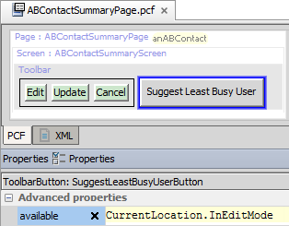


Determing edit mode
CurrentLocation. InEditMode
Returns true if current location is in edit mode
Returns false if current location is in read-only mode
Toolbar button example:
Clicking Edit puts the location into edit mode and button is available for the user to click
Available=false
Available=true
Notes:
In the slide example, when a user clicks the Edit button, the location (page) transitions from read-only to edit mode. When the location is in edit mode, the SuggestLeastBusyUserButton becomes available for a user to click. The available property for the toolbar button has a expression that returns true when the loocation is in Edit mode: CurrentLocation.InEditMode.
You can also use a combination of button widgets and Gosu expressions to control the edit mode of a location without edit buttons. To create a custom button that puts the current location into edit mode just like an edit button, follow these steps:
In Studio, add a Toolbar Button widget to the desired toolbar.
Click the Properties tab.
Specify CurrentLocation.startEditing() for the action property.
Configure other properties of the widget as desired.
Reload PCFs
<number>

Slide 13
Discover editability
Configure the editability of a detail view panel
Notes:
<number>

Slide 14
Toolbars
A toolbar is row of data action buttons and other widgets associated with a specific container widget
Usually has Edit Buttons
Toolbar with Edit Buttons
Direct placement
Screen, Panel Ref, List View Input
Referenced containers
Card View Panel
Detail View Panel
List Detail Panel
List View Panel
Notes:
A toolbar is a row of widgets associated with a container widget that lets the user take action on the data in the container widget.
A toolbar can be directly add to a Screen, Panel Ref, or List View Input. Toolbars can also be associated with Detail View Panels, Card View Panels, List Detail Panels, and List View Panels. However, there is no direct placement or reference with an Input Set. Typically, an Input Set is referenced or placed in an Input Column in a Detail View Panel.
A toolbar usually has button widgets such as Edit Buttons. When a toolbar is associated with a list view panel, the toolbar may not have any button widgets. This is configuration is covered later in the course.
<number>

Slide 15
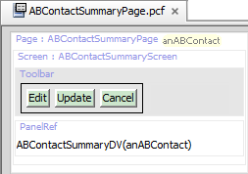
Anatomy of an editable detail view panel
Screen
Toolbar
Edit Buttons
Panel Ref
Referenced detail view panel
Screen is top level container with Toolbar and Edit Buttons
Panel Ref is a child of Screen and references a Detail View Panel
Possible to use inline Detail View Panel instead of Panel Ref
Notes:
In the slide example, editability is set on the Page location in the canEdit property. The ABContactSummaryPage uses a PanelRef element to reference the ABContactSummaryDV detail view panel.
<number>

Slide 16
Steps to add edit buttons
Locate top-level screen container
Add toolbar to screen
Add edit buttons to toolbar
Deploy PCFs
Notes:
<number>

Slide 17
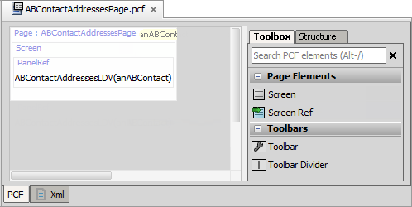
Step 1: Locate top-level screen container
Screen
Screen is a top-level container and is found in a location
Notes:
<number>

Slide 18
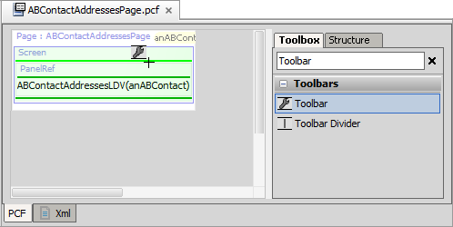
Step 2: Add toolbar to screen
Light green line - current place where new widget will go
Dark green line - places where new widget can go
Add a Toolbar to the top-level Screen element
Notes:
<number>

Slide 19
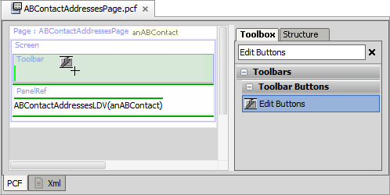
Step 3: Add edit buttons to toolbar
Add the Edit Buttons to the toolbar
Notes:
For edit buttons, it is ideal to add the toolbar to the top-level container and then add the edit buttons to the toolbar.
<number>

Slide 20
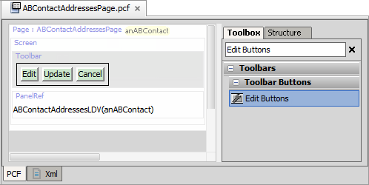
Toolbar with edit buttons
EditButtons widget includes Edit|Update|Cancel buttons
Edit shows in read-only mode
Update and Cancel show in edit mode
Notes:
<number>

Slide 21
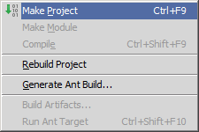
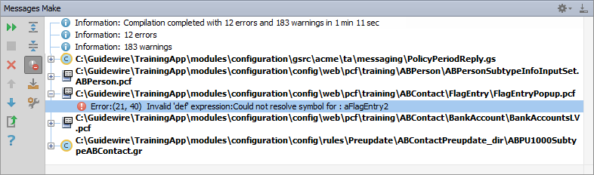
Make project to see all PCF errors
Build → Make Project
Compiles only modified files since the last compilation
Opens Messages (Make) window for build summary
Filter for errors
Great way to see all PCF errors
Notes:
Make Project: All the source files in the entire project that have been modified since the last compilation are compiled. Dependent source files, if appropriate, are also compiled. Additionally, the tasks tied to the compilation or make process on modified sources are performed.
<number>

Slide 22
Step 4: Deploy PCFs
Restart Server
Reload PCFs
PCFs read at server startup
ALT+SHIFT+L
Internal debug tools enabled
Internal Tools
Reload → Reload PCF Files
Page PCF
Page PCF
Notes:
It is also possible to reload PCF files using the Guidewire API and/or internal server tools. The Reload PCF command can be found on the Reload page in Internal Tools. To access Internal Tools, the EnableInternalDebugTools setting in the config.xml file must be set to true. The keystroke to open the Internal Tools page is ALT+SHIFT+T. In the tab bar, select Internal Tools --> Reload. On the Reload page, click the Reload PCF Files button. Both the keystroke ALT+SHIFT+L and the Reload PCF Files button call the same static method: gw.api.tools.InternalToolsUtil.reloadPCFs().
<number>

Slide 23
Describe how to make a detail view panel editable
Create a toolbar with edit buttons
Notes:
<number>

Slide 24
A screen with card view panel references a detail view panel. The detail view panel contains a text input widget. To allow the user to edit the text input value, what must be set to editable?
In Studio, can you add Edit Buttons directly to
An inline DetailViewPanel widget?
A detail view panel PCF file?
Where do you typically add a toolbar with edit buttons?
Notes:
Answers
1) The input widget and all of the containers that directly or indirectly contain it must be editable. The editable hierarchy begins with a location PCF Element. Assuming that the Screen declared in a Page location, then the Page location must be editable.
2a) No, you cannot add Edit Buttons directly to a DetailViewPanel widget. Typically, you add a Toolbar to a Screen. Then you add Edit Buttons to the Toolbar. A DetailViewPanel widget can be declared on a Screen.
2b) No, you cannot add Edit Buttons directly to a Detail View Panel PCF file. Typically, you add a Toolbar to a Screen. Then you add Edit Buttons to the Toolbar. A Panel Ref can reference the Detail View Panel PCF file.
3) You add a toolbar with edit buttons typically to the Screen container element.
<number>

Slide 25
Notes:
<number>

